Slide 1

DIVINE GRACE COLLEGE OF ARTS, SCIENCE AND TECHNOLOGY
(DGCAST) — GAROUA | GEOGRAPHY DEPARTMENT
UPPER SIXTH ARTS — SETTLEMENT GEOGRAPHY — LESSON 13
Urban Regions: Millionaire Cities, Conurbations and Megalopolis
Mr KAMDEM EMMANUEL
Geography Teacher — PLEG
Academic Year 2026 / 2027
Notes:
Good morning, class. Today we study Lesson 13: Urban Regions: Millionaire Cities, Conurbations and Megalopolis.

Slide 2
GEOGRAPHY — UPPER SIXTH ARTS
CLASS INFO
Class, Chapter & Duration
Class | Upper Sixth Arts
Chapter | Module 5: Understanding and managing settlement dynamics across the world in general and Cameroon in particular
Duration | 2 periods (2 × 50 minutes)
2026 / 2027
DGCAST GAROUA — GEOGRAPHY DEPARTMENT
Mr KAMDEM E. | 2

Slide 3
GEOGRAPHY — UPPER SIXTH ARTS
IDENTIFICATION
Lesson Identification
Topic | Urban Settlement and Urbanisation
Sub-topic | Urban Growth
Lesson | Lesson 13: Urban Regions: Millionaire Cities, Conurbations and Megalopolis
Notions / Concepts | Millionaire city, megacity, conurbation, megalopolis.
Syllabus focus | Meaning, world distribution, examples and causes of millionaire cities, conurbations and megalopolis.
Competence | Learners are able to describe very large urban regions and explain their growth.
2026 / 2027
DGCAST GAROUA — GEOGRAPHY DEPARTMENT
Mr KAMDEM E. | 3

Slide 4
GEOGRAPHY — UPPER SIXTH ARTS
OBJECTIVES
Learning Objectives
By the end of the lesson, the learner should be able to:
Define millionaire city, conurbation and megalopolis.
Describe their world distribution.
Explain the causes of their growth.
2026 / 2027
DGCAST GAROUA — GEOGRAPHY DEPARTMENT
Mr KAMDEM E. | 4

Slide 5
GEOGRAPHY — UPPER SIXTH ARTS
RECALL
Recall
Urbanisation is fast in LEDCs.
Cities spread into the countryside.
2026 / 2027
DGCAST GAROUA — GEOGRAPHY DEPARTMENT
Mr KAMDEM E. | 5

Slide 6
GEOGRAPHY — UPPER SIXTH ARTS
REAL-LIFE SITUATION
Real-Life Situation
Tokyo has about 37 million people, more than Cameroon. Lagos grows by about 3,000 people every day. Between Boston and Washington, cities have merged into one long urban region.
2026 / 2027
DGCAST GAROUA — GEOGRAPHY DEPARTMENT
Mr KAMDEM E. | 6
Notes:
Read the situation slowly, twice.

Slide 7
GEOGRAPHY — UPPER SIXTH ARTS
REAL-LIFE SITUATION
Situation — Question 1
What is the problem in the situation?
2026 / 2027
DGCAST GAROUA — GEOGRAPHY DEPARTMENT
Mr KAMDEM E. | 7

Slide 8
GEOGRAPHY — UPPER SIXTH ARTS
REAL-LIFE SITUATION
Answer
Some cities have become enormous.
2026 / 2027
DGCAST GAROUA — GEOGRAPHY DEPARTMENT
Mr KAMDEM E. | 8

Slide 9
GEOGRAPHY — UPPER SIXTH ARTS
REAL-LIFE SITUATION
Situation — Question 2
What is a city of over 10 million called?
2026 / 2027
DGCAST GAROUA — GEOGRAPHY DEPARTMENT
Mr KAMDEM E. | 9

Slide 10
GEOGRAPHY — UPPER SIXTH ARTS
REAL-LIFE SITUATION
Answer
A megacity.
2026 / 2027
DGCAST GAROUA — GEOGRAPHY DEPARTMENT
Mr KAMDEM E. | 10

Slide 11
GEOGRAPHY — UPPER SIXTH ARTS
REAL-LIFE SITUATION
Situation — Question 3
What is a chain of merged cities called?
2026 / 2027
DGCAST GAROUA — GEOGRAPHY DEPARTMENT
Mr KAMDEM E. | 11

Slide 12
GEOGRAPHY — UPPER SIXTH ARTS
REAL-LIFE SITUATION
Possible Answer
A megalopolis.
2026 / 2027
DGCAST GAROUA — GEOGRAPHY DEPARTMENT
Mr KAMDEM E. | 12

Slide 13
GEOGRAPHY — UPPER SIXTH ARTS
JUSTIFICATION
Justification of the Lesson
This lesson helps us to understand the giant cities of the world.
2026 / 2027
DGCAST GAROUA — GEOGRAPHY DEPARTMENT
Mr KAMDEM E. | 13

Slide 14
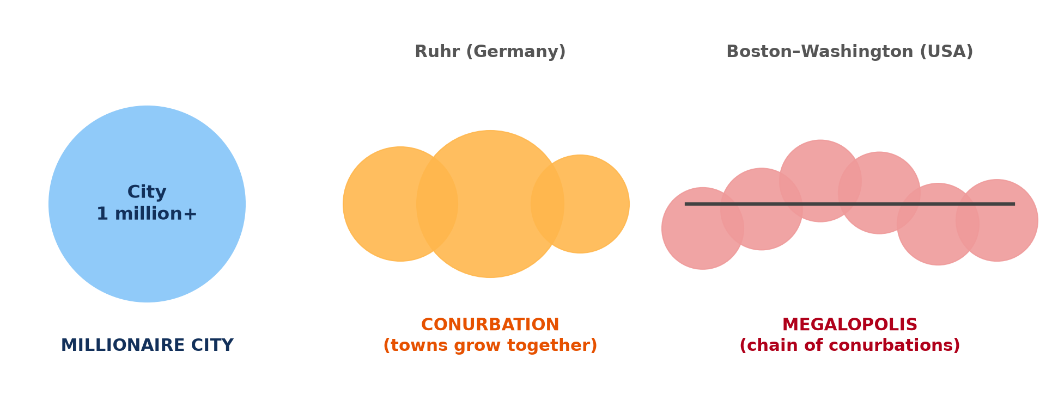
GEOGRAPHY — UPPER SIXTH ARTS
I. TYPES
Activity 1
Millionaire city, conurbation and megalopolis.
2026 / 2027
DGCAST GAROUA — GEOGRAPHY DEPARTMENT
Mr KAMDEM E. | 14
Notes:
Without the projector: draw the three forms.

Slide 15
GEOGRAPHY — UPPER SIXTH ARTS
I. TYPES
Activity 1: Question
What is a conurbation?
2026 / 2027
DGCAST GAROUA — GEOGRAPHY DEPARTMENT
Mr KAMDEM E. | 15

Slide 16
GEOGRAPHY — UPPER SIXTH ARTS
I. TYPES
Answer
Several towns that have grown together into one urban area.
2026 / 2027
DGCAST GAROUA — GEOGRAPHY DEPARTMENT
Mr KAMDEM E. | 16

Slide 17
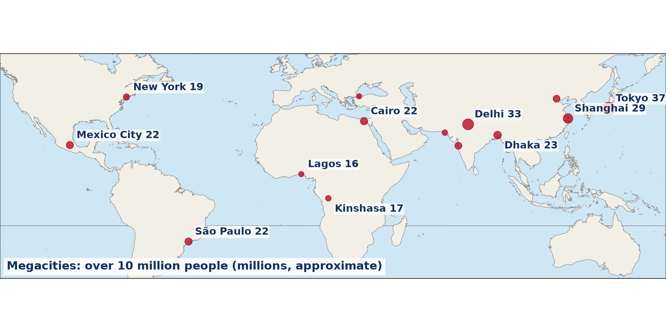
GEOGRAPHY — UPPER SIXTH ARTS
II. DISTRIBUTION
Activity 2
Megacities of the world (approximate).
2026 / 2027
DGCAST GAROUA — GEOGRAPHY DEPARTMENT
Mr KAMDEM E. | 17
Notes:
Without the projector: find the megacities on a map.

Slide 18
GEOGRAPHY — UPPER SIXTH ARTS
II. DISTRIBUTION
Activity 2: Question
In which continent are most megacities today?
2026 / 2027
DGCAST GAROUA — GEOGRAPHY DEPARTMENT
Mr KAMDEM E. | 18

Slide 19
GEOGRAPHY — UPPER SIXTH ARTS
II. DISTRIBUTION
Answer
Asia.
2026 / 2027
DGCAST GAROUA — GEOGRAPHY DEPARTMENT
Mr KAMDEM E. | 19

Slide 20
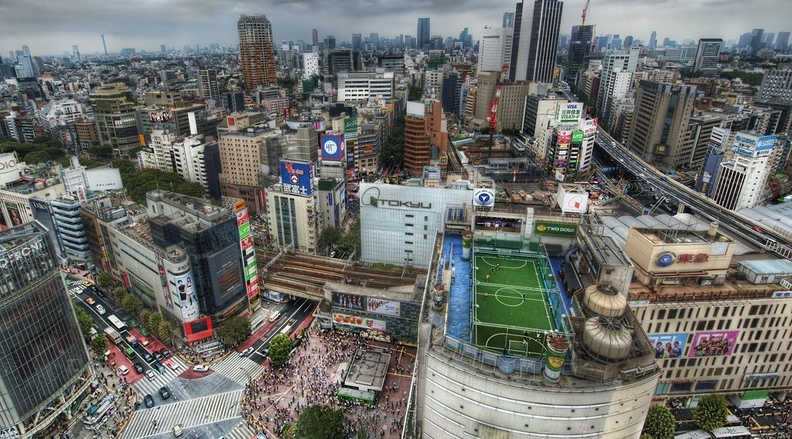
GEOGRAPHY — UPPER SIXTH ARTS
II. EXAMPLES
Activity 3
Tokyo from the air.
2026 / 2027
DGCAST GAROUA — GEOGRAPHY DEPARTMENT
Mr KAMDEM E. | 20
Notes:
Without the projector: find Tokyo.

Slide 21
GEOGRAPHY — UPPER SIXTH ARTS
II. EXAMPLES
Activity 3: Question
Why is Tokyo the largest urban region?
2026 / 2027
DGCAST GAROUA — GEOGRAPHY DEPARTMENT
Mr KAMDEM E. | 21

Slide 22
GEOGRAPHY — UPPER SIXTH ARTS
II. EXAMPLES
Answer
It is a major centre of industry, finance and government with good transport.
2026 / 2027
DGCAST GAROUA — GEOGRAPHY DEPARTMENT
Mr KAMDEM E. | 22

Slide 23

GEOGRAPHY — UPPER SIXTH ARTS
III. CAUSES
Activity 4
A crowded market (Lagos region).
2026 / 2027
DGCAST GAROUA — GEOGRAPHY DEPARTMENT
Mr KAMDEM E. | 23
Notes:
Without the projector: compare Lagos and Douala.

Slide 24
GEOGRAPHY — UPPER SIXTH ARTS
III. CAUSES
Activity 4: Question
Why do African cities like Lagos grow so fast?
2026 / 2027
DGCAST GAROUA — GEOGRAPHY DEPARTMENT
Mr KAMDEM E. | 24

Slide 25
GEOGRAPHY — UPPER SIXTH ARTS
III. CAUSES
Answer
Rural-urban migration and high natural increase.
2026 / 2027
DGCAST GAROUA — GEOGRAPHY DEPARTMENT
Mr KAMDEM E. | 25

Slide 26

GEOGRAPHY — UPPER SIXTH ARTS
III. PROBLEMS
Activity 5
Traffic in a big city.
2026 / 2027
DGCAST GAROUA — GEOGRAPHY DEPARTMENT
Mr KAMDEM E. | 26
Notes:
Without the projector: list problems.

Slide 27
GEOGRAPHY — UPPER SIXTH ARTS
III. PROBLEMS
Activity 5: Question
Give two problems of megacities.
2026 / 2027
DGCAST GAROUA — GEOGRAPHY DEPARTMENT
Mr KAMDEM E. | 27

Slide 28
GEOGRAPHY — UPPER SIXTH ARTS
III. PROBLEMS
Answer
Congestion and slums (also pollution, water shortage).
2026 / 2027
DGCAST GAROUA — GEOGRAPHY DEPARTMENT
Mr KAMDEM E. | 28

Slide 29
GEOGRAPHY — UPPER SIXTH ARTS
BOARD SUMMARY
Urban Regions: Millionaire Cities, Conurbations and Megalopolis
Topic: Urban Settlement and Urbanisation
Sub-topic: Urban Growth
Lesson 13: Urban Regions: Millionaire Cities, Conurbations and Megalopolis
2026 / 2027
DGCAST GAROUA — GEOGRAPHY DEPARTMENT
Mr KAMDEM E. | 29
Notes:
Learners copy the board summary now. Give them enough time for each slide.

Slide 30
GEOGRAPHY — UPPER SIXTH ARTS
BOARD SUMMARY
I. Definitions (1/2)
Millionaire city: It is a city with over one million people.
Conurbation: It is a large urban area formed when towns grow together.
Megalopolis: It is a very large chain of linked conurbations.
2026 / 2027
DGCAST GAROUA — GEOGRAPHY DEPARTMENT
Mr KAMDEM E. | 30

Slide 31
GEOGRAPHY — UPPER SIXTH ARTS
BOARD SUMMARY
I. Definitions (2/2)
Megacity: It is a city with over ten million people.
2026 / 2027
DGCAST GAROUA — GEOGRAPHY DEPARTMENT
Mr KAMDEM E. | 31

Slide 32
GEOGRAPHY — UPPER SIXTH ARTS
BOARD SUMMARY
II. Distribution and Examples (1/2)
A. Millionaire cities: There are over 500 in the world, many in Asia. In Cameroon, Douala and Yaoundé are millionaire cities.
B. Conurbations: Examples are the Ruhr in Germany and Greater Manchester. Lagos and Johannesburg-Pretoria are African examples.
2026 / 2027
DGCAST GAROUA — GEOGRAPHY DEPARTMENT
Mr KAMDEM E. | 32

Slide 33
GEOGRAPHY — UPPER SIXTH ARTS
BOARD SUMMARY
II. Distribution and Examples (2/2)
C. Megalopolis: The Boston–Washington corridor and Tokyo–Osaka are examples. They are found mainly in rich, industrial regions.
2026 / 2027
DGCAST GAROUA — GEOGRAPHY DEPARTMENT
Mr KAMDEM E. | 33

Slide 34
GEOGRAPHY — UPPER SIXTH ARTS
BOARD SUMMARY
III. Causes (1/2)
A. In MEDCs: Industry, trade and transport links joined towns together. Suburbs spread along roads and railways.
B. In LEDCs: Rural-urban migration and natural increase make cities grow fast. Capitals and ports attract most people.
2026 / 2027
DGCAST GAROUA — GEOGRAPHY DEPARTMENT
Mr KAMDEM E. | 34

Slide 35
GEOGRAPHY — UPPER SIXTH ARTS
BOARD SUMMARY
III. Causes (2/2)
C. Effects: Big cities offer many jobs and services. They also suffer congestion, slums and pollution.
2026 / 2027
DGCAST GAROUA — GEOGRAPHY DEPARTMENT
Mr KAMDEM E. | 35

Slide 36
GEOGRAPHY — UPPER SIXTH ARTS
FORMATIVE EVALUATION
Formative Evaluation 1
Distinguish a conurbation and a megalopolis.
2026 / 2027
DGCAST GAROUA — GEOGRAPHY DEPARTMENT
Mr KAMDEM E. | 36

Slide 37
GEOGRAPHY — UPPER SIXTH ARTS
FORMATIVE EVALUATION
Expected Answer
A conurbation is towns grown together; a megalopolis is a chain of conurbations.
2026 / 2027
DGCAST GAROUA — GEOGRAPHY DEPARTMENT
Mr KAMDEM E. | 37

Slide 38
GEOGRAPHY — UPPER SIXTH ARTS
FORMATIVE EVALUATION
Formative Evaluation 2
Give two megacities and their continents.
2026 / 2027
DGCAST GAROUA — GEOGRAPHY DEPARTMENT
Mr KAMDEM E. | 38

Slide 39
GEOGRAPHY — UPPER SIXTH ARTS
FORMATIVE EVALUATION
Expected Answer
Tokyo (Asia) and Lagos (Africa) (also São Paulo, Mexico City).
2026 / 2027
DGCAST GAROUA — GEOGRAPHY DEPARTMENT
Mr KAMDEM E. | 39

Slide 40
GEOGRAPHY — UPPER SIXTH ARTS
REMEDIATION
Remediation
Fill in the blanks:
A city with over 10 million people is a ______.
Towns grown together form a ______.
Boston–Washington is a ______.
2026 / 2027
DGCAST GAROUA — GEOGRAPHY DEPARTMENT
Mr KAMDEM E. | 40
Notes:
Answers: 1. megacity 2. conurbation 3. megalopolis

Slide 41
GEOGRAPHY — UPPER SIXTH ARTS
HOMEWORK
Homework
Name five megacities and mark them on a world map.
This prepares Lesson 14: Urban Fields.
2026 / 2027
DGCAST GAROUA — GEOGRAPHY DEPARTMENT
Mr KAMDEM E. | 41
Notes:
This homework prepares the next lesson.

Slide 42
GEOGRAPHY — UPPER SIXTH ARTS
BILINGUAL GAME
Bilingual Game (Jeu Bilingue)
English | Français
Megacity | La mégapole
Conurbation | L'agglomération (conurbation)
Megalopolis | La mégalopole
Million | Le million
Corridor | Le corridor
Growth | La croissance
2026 / 2027
DGCAST GAROUA — GEOGRAPHY DEPARTMENT
Mr KAMDEM E. | 42
Notes:
Say the English word; learners give the French word, then the reverse.

Slide 43
GEOGRAPHY — UPPER SIXTH ARTS
LOGBOOK
Official Logbook (1/2)
Module / Topic | Urban Settlement and Urbanisation
Lesson Title | Lesson 13: Urban Regions: Millionaire Cities, Conurbations and Megalopolis
Expected Learning Outcomes | Define millionaire city, conurbation and megalopolis. Describe their world distribution. Explain the causes of their growth.
Competence | Learners are able to describe very large urban regions and explain their growth.
2026 / 2027
DGCAST GAROUA — GEOGRAPHY DEPARTMENT
Mr KAMDEM E. | 43

Slide 44
GEOGRAPHY — UPPER SIXTH ARTS
LOGBOOK
Official Logbook (2/2)
Matter Taught | I. Definitions: Millionaire city, Conurbation, Megalopolis, Megacity; II. Distribution and Examples: Millionaire cities, Conurbations, Megalopolis; III. Causes: In MEDCs, In LEDCs, Effects.
Evaluation | Formative evaluation (3 questions) and remediation exercise.
Homework | Name five megacities and mark them on a world map.
Enrolment / Present / Absent | ____ / ____ / ____
Achievement | To be completed by the teacher after the lesson.
2026 / 2027
DGCAST GAROUA — GEOGRAPHY DEPARTMENT
Mr KAMDEM E. | 44

Slide 45
GEOGRAPHY — UPPER SIXTH ARTS
TEACHER'S NOTE
Teacher's Note
Timing: Set-up, recall 8 min | Situation 8 min | 5 activities 30 min | Board summary (copying) 30 min | Evaluation, remediation 10 min | Homework, logbook 9 min | Spare 5 min
2026 / 2027
DGCAST GAROUA — GEOGRAPHY DEPARTMENT
Mr KAMDEM E. | 45

Slide 46
GEOGRAPHY — UPPER SIXTH ARTS
REFERENCES
References
National Geography Syllabus, Sixth Forms (Lower & Upper Sixth), MINESEC/IGE/IP-SS, August 2019 — Module 5 (Settlement Geography).
Photo, Activity 3: “Tokyo from the Air” by Trey Ratcliff, CC BY-NC-SA 2.0, via Flickr (https://www.flickr.com/photos/95572727@N00/4140101118)
Photo, Activity 4: “Wax market” by zouzouwizman, CC BY 2.0, via Flickr (https://www.flickr.com/photos/61111202@N00/12129001)
Photo, Activity 5: “Nairobi Traffic Jam” by rogiro, CC BY-NC 2.0, via Flickr (https://www.flickr.com/photos/43132185@N00/48712135)
Diagrams and animations: drawn for this lesson (DGCAST Geography Department).
2026 / 2027
DGCAST GAROUA — GEOGRAPHY DEPARTMENT
Mr KAMDEM E. | 46

